Slide 1
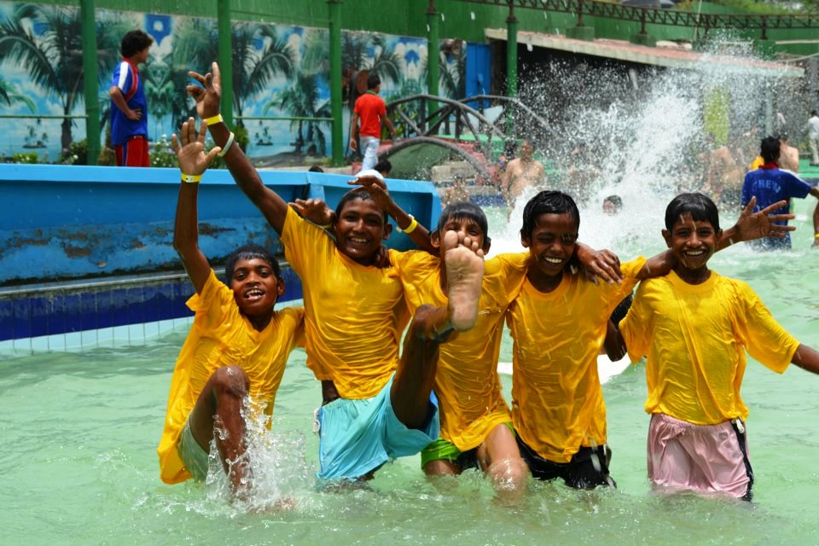
BUTTERFLIES - NEW DELHI
New Delhi based NGO supporting street and working children
Established in 1989.
Employs 140 staff - Delhi and the Andaman Islands.
Annual revenue of just under £1 million
85% of funding comes from outside of India.
Notes:
New Delhi based NGO supporting street and working children, which was established in 1989.
It employs 140 staff mainly in the Delhi area but has 40 people in the Andaman Islands.
It has an annual revenue of just under one million pounds.
85% of its funding comes from outside of India.
It's funding comes from around a dozen different NGOs or similar organisations.
About 35% of its total income comes from Childhope a UK NGO.

Slide 2

WHY BUTTERFLIES?… WHY INDIA?
Knew very little about India - the country has always fascinated me.
Wanted to work in a city not in the back of beyond.
Relate to the NGO’s objectives & felt Butterflies was a worthwhile organisation.
My skills matched the requirements of the role.
To challenge myself by doing something outside my comfort zone.
Three month assignment - long enough to get to know
a bit about the place and the people.
Notes:
I previously knew very little about India but the country has always fascinated me.
I wanted to work in a city not in the back of beyond.
I could relate to the objectives of the NGO and felt that Butterflies was a worthwhile organisation.
I felt my skills matched the requirements of the role.
I wanted to challenge myself by doing something outside my comfort zone.
The assignment was for three months - long enough to get to know a bit about the place and the people.

Slide 3
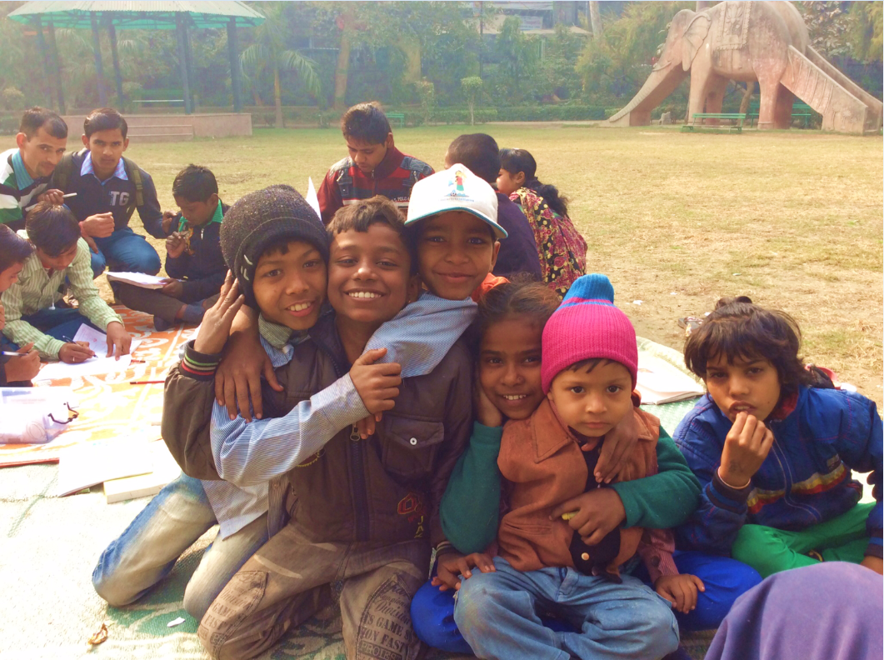

Slide 4
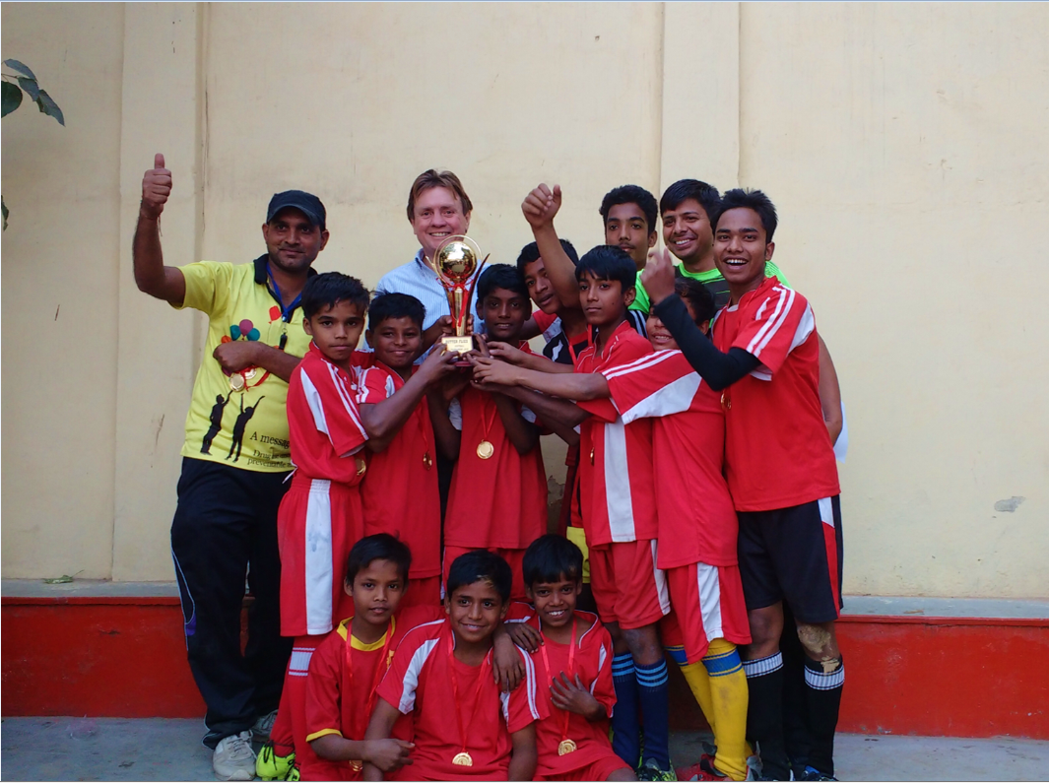

Slide 5
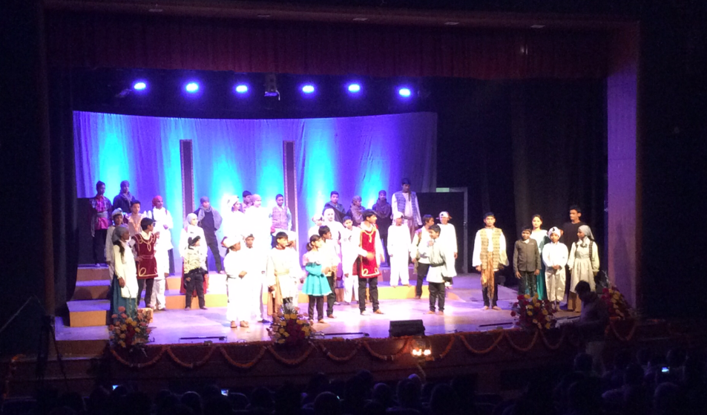

Slide 6
MY ROLE
Review processes and financial controls
Identify gaps and make recommendations
Assist with Budgeting and Cash Flow forecasting
Additional duties as agreed with the Finance Manager
My role adapted and changed based my initial assessments of need
Including: setting up a simple rolling monthly system of forecasting and planning
Notes:
Review processes and financial controls
Identify gaps and make recommendations
Assist with Budgeting and Cash Flow forecasting
Additional duties as agreed with the Finance Manager
How the role changed:
Review of the existing procedures and controls indicated limited need for improvement.
Internal and external audits were regularly undertaken.
Donor reporting was the area that needed improvement, along with financial planning and forecasting.
Financial Reporting to the board was limited to the Annual Accounts.
I focused on setting up a simple rolling monthly system of forecasting and planning that incorporated a full year’s budget.

Slide 7
WHAT SKILLS I USED
Basic accounting skills – nothing too complicated
Excel
People skills
Communication skills
Set up an Anti Fraud policy and updated certain other policies

Slide 8
LIVING AND WORKING IN INDIA
My day at work
Social activities: Sports clubs and societies; met friends of friends; activities outside of work.
Transport in New Delhi - easy and cheap
Metro and taxis, (Uber!) and Auto Rickshaws.
Food - always fresh, cheap and excellent quality.
Tip: drink bottled water and avoid pre-cooked street food.
Medical treatment is good and cheap
Medical insurance for someone of my age was expensive.
Notes:
My day at work
Outside work I joined sports clubs and societies, made contact with friends of friends and took up all offers of activities outside of work.
Getting around New Delhi was easy and cheap, they have an excellent metro and taxis (they also have Uber) are unbelievably cheap and Auto Rickshaws are even cheaper.
Food was always fresh and can be exceptionally cheap and the quality is excellent, but drink bottled water and avoid pre-cooked street food.
Medical treatment is good and cheap, but medical insurance for someone of my age was expensive.

Slide 9
LIVING AND WORKING IN INDIA
Security:
  I never felt unsafe or threatened
  People were very polite and respectful.
  At work they insisted on calling me Mr John.
  On the underground I was offered a seat on numerous occasions, something that has not yet happened in London.
Exploring the sights and markets of New Delhi
Visited other parts of India in my free time
Notes:
Security: I never felt unsafe or threatened, people were very polite and respectful. At work they insisted on calling me Mr John. On the underground I was offered a seat on numerous occasions, something that has not yet happened in London.
The pollution was an issue, as was the traffic.
I spent a lot of time exploring the sights and markets of New Delhi.
I also took time off in the middle and at the end of my assignment to visit other parts of India.

Slide 10
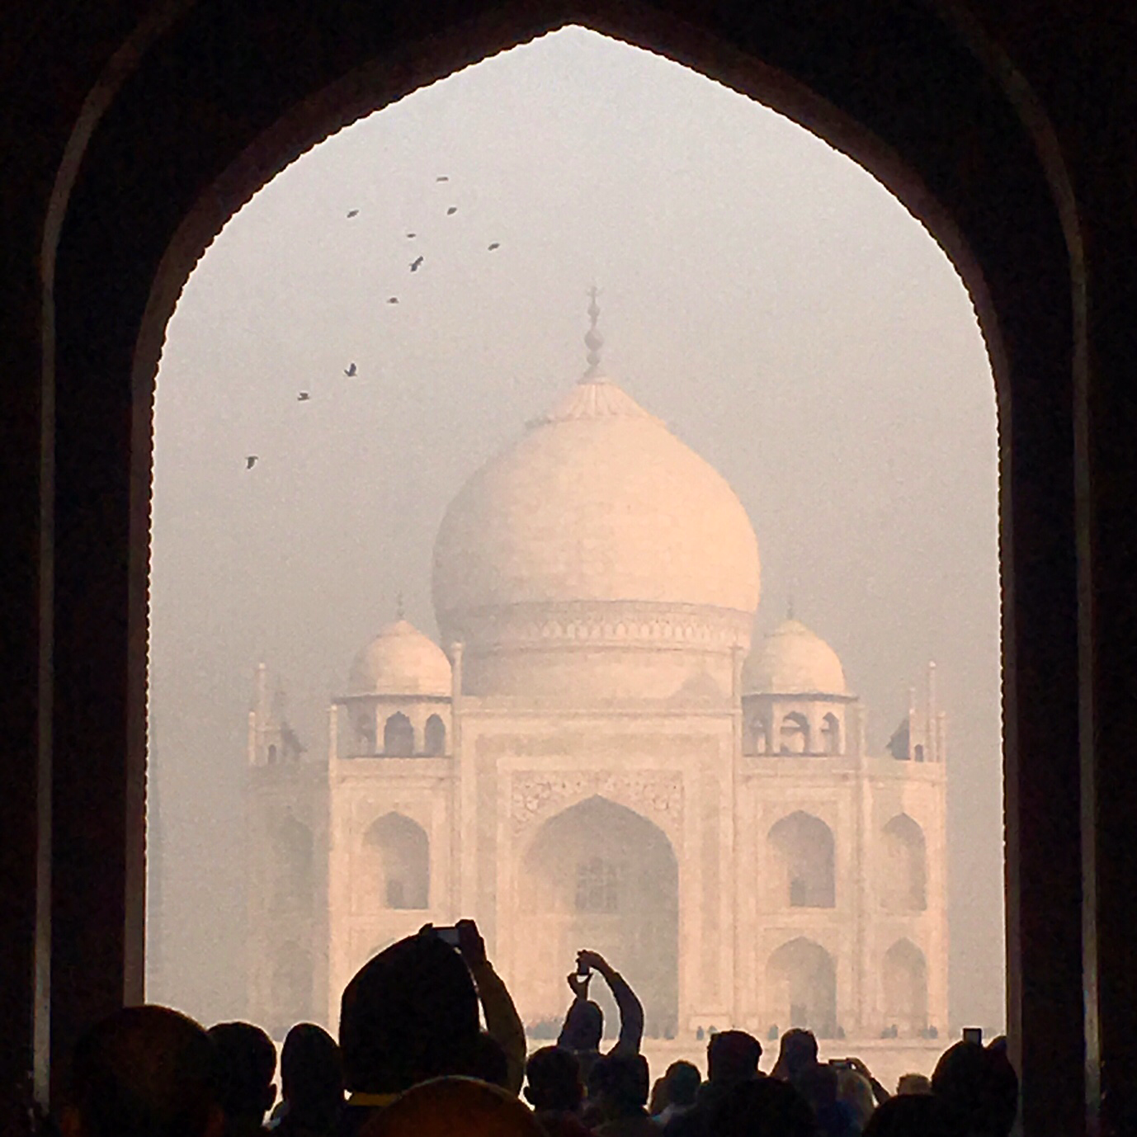
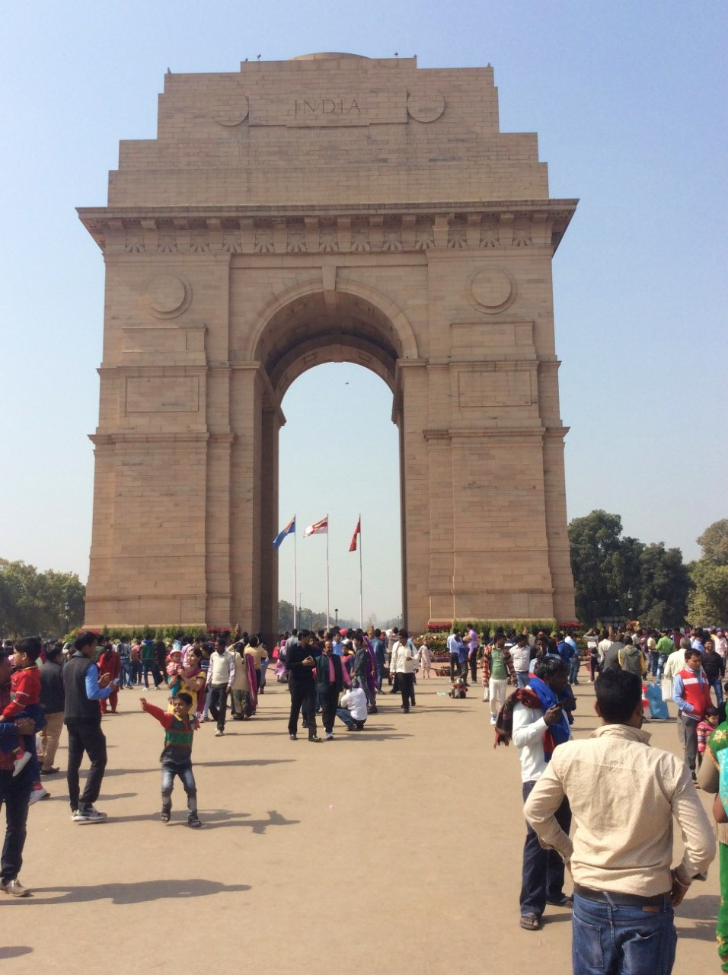

Slide 11
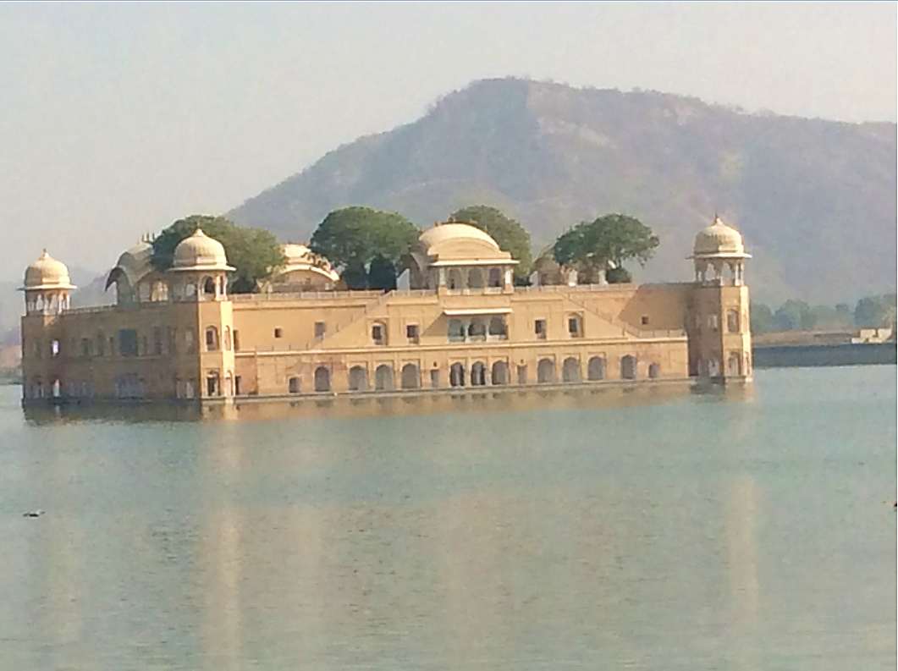

Slide 12
OBSERVATIONS AND ADVICE
Be patient - the pace can be very slow.
Understand your organisation and visit some off-site activities.
Ensure local staff will be able to sustain any changes without you.
Take time off to explore the country. Don't waste the opportunity!
Get involved in any outside opportunity the may be available.
If someone comes to work having shaved their head, be careful what you say!
Notes:
Be patient at work and with any officials you may have to deal with - the pace can be very slow.
Understand your organisation, what it does and what it is good at, before submerging yourself in the accounting detail. Get out and visit some of the off-site activities.
Whatever changes you may make, ensure that the local staff will be able to sustain them once you have gone.
Take time off in the middle or at the end of your assignment to explore the country. Don't waste the opportunity.
Get involved in any outside opportunity the may be available.
If someone comes to work having shaved their head, be careful what you say!

Slide 13
OBSERVATIONS AND ADVICE
Find other individuals doing something similar in your area (through AfID or your embassy)
Research the country before you go.
Take an ipad or something similar.
Write a blog: the best way to let your family and friends know what you are up to.
Don’t take too much if you’re in a city, you can buy most things cheaper
Be positive and make sure you enjoy yourself.
Notes:
Contact your embassy (of AfID!!) as they may be able to put you in touch with people doing something similar in your area.
Research the country before you go.
Take an Ipad or something similar - I subscribed to the online version of The Times, enabling me to read the news over my breakfast.
Write a blog. The best way to let your family and friends know what you are up to.
No need to take too much with you if you are going to a big city - almost everything was available at about one third of the UK price.
Be positive and make sure you enjoy yourself.

Slide 14
